Slide 1
Project Review 2
A novel machine learning approach to predict the band gap of binary compounds using known properties

Slide 2
Plan
Cleaning and presenting the required data from the Materials Project
Build a machine learning model (Linear Regression) using naïve features
Improve the accuracy of the model by using physical features
Use different models (Ridge, Random Forest) to improve the accuracy
Convert regression problem to classification problem
Compare and analyze the results obtained from the different models
Develop a web application to encapsulate the complete tool

Slide 3
Cleaning and Presenting the Data
The data was obtained from the materialsproject.org using the API
The main features we use here are:
Atomic fraction
Electronegativity difference
Position of the constituent elements in the periodic table
Cumulative atomic numbers of the elements
Handled inconsistencies in the data
Analyzed the correlation between features and the band gap

Slide 4
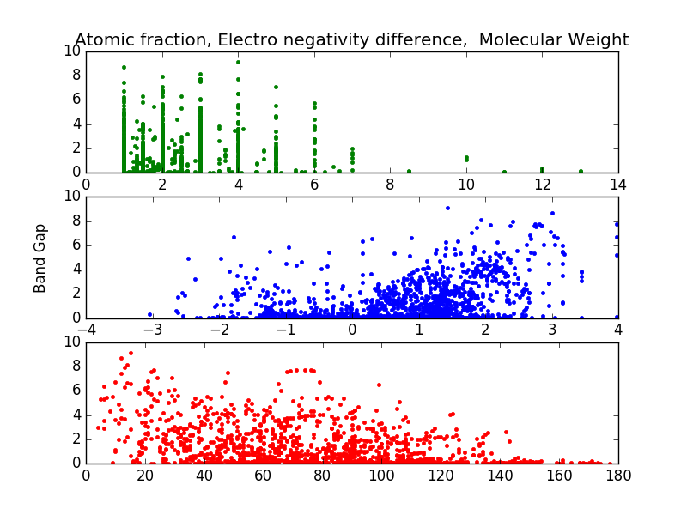
Graphs

Slide 5
Regression Model
The MAE of always guessing the band gap is 0.728 eV
Linear regression using naïve features gives an MAE of 0.47 eV
Linear regression using physical features gives an MAE of 0.6 eV
Using Random Forrest we get an MAE of 0.243 eV

Slide 6
Convert regression problem to classification problem
The regression problem is converted into classification problem by creating buckets of size 0.25eV
1
2
3
4
5
6
0 - 0.25 eV
1.25 – 1.5 eV

Slide 7
In classification we can calculate the accuracy of each prediction unlike regression
Decision tree gives an accuracy of about 85%
Using SVM we get an accuracy of 91.423%
Further estimating the band gap using ensemble methods like Random Forest we get a accuracy of 91 to 92.2%

Slide 8
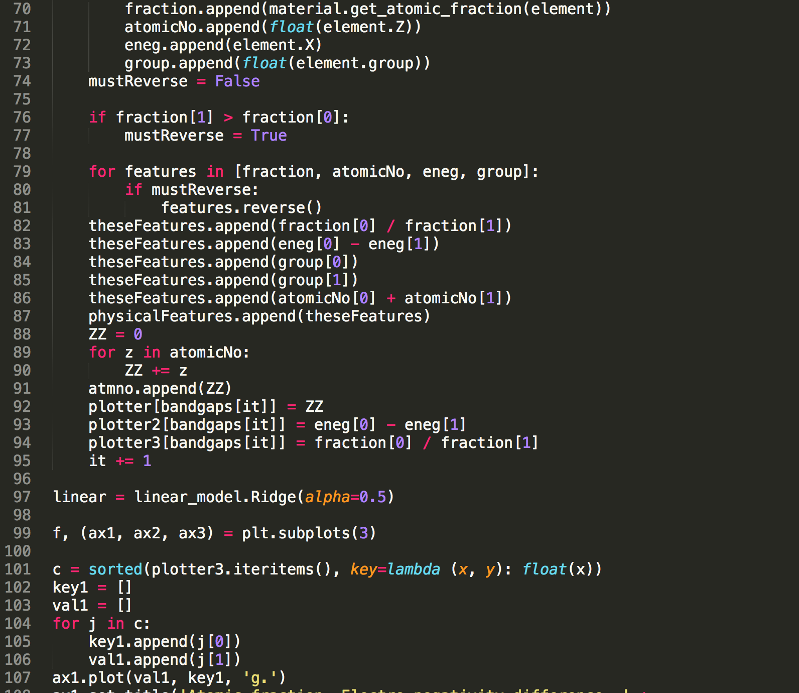

Slide 9
Future Work
Develop a responsive web interface, which returns the band gap for the given binary compound
Provide an API for material researchers to use this tool
Open source the project
Work on publishing our work in a reputed journal

